Slide 1
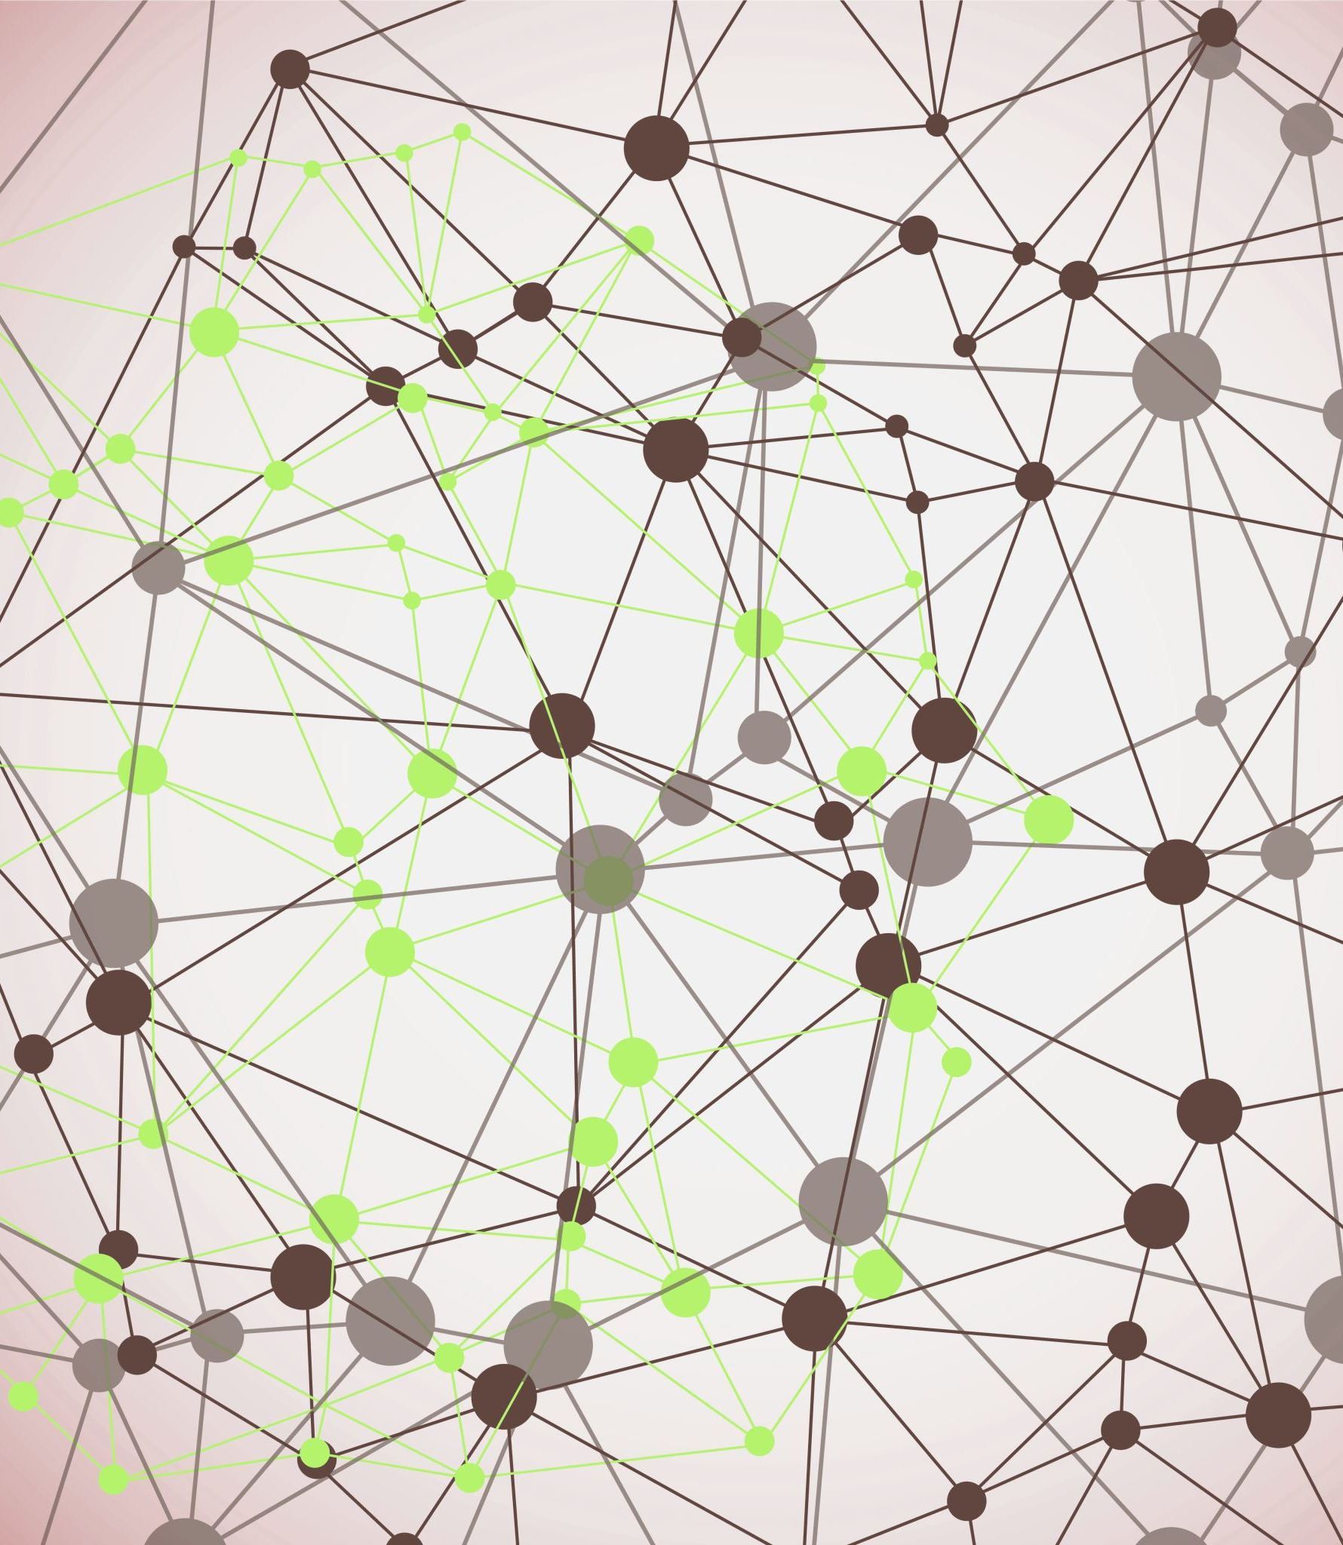
Sign Language Recognition System

Slide 2

Problem Statement and Solution
Problem: Communication barriers faced by the deaf and hard-of-hearing community due to the lack of real-time translation tools for sign language
Solution: A mobile app that uses advanced machine learning and computer vision technologies to translate sign language from a live video into text in real-time
Benefits: Improves accessibility and facilitates easier communication

Slide 3

Technology Stack
MediaPipe: For real-time gesture tracking
TensorFlow: To train the machine learning model for sign recognition
OpenCV : For additional image processing needs
Flutter: For developing a cross-platform application

Slide 4

Challenges
Real-time Processing: Ensuring the app processes sign language gestures quickly and accurately
User Engagement: Designing an intuitive user interface that is easy for all users, including those unfamiliar with technology

Slide 5
Impact
Enhancing Daily Life: The app provides a crucial communication tool for the deaf and hard-of-hearing community, allowing for easier interaction in daily activities such as shopping, doctor's visits, and social gatherings.
Improving Learning Outcomes: By facilitating communication between educators and students who use sign language, the app enhances educational opportunities and supports more inclusive classrooms.
Promoting Inclusivity: This technology bridges a significant gap in accessibility, promoting equal opportunities for participation in society and fostering a more inclusive community for individuals who are deaf or hard-of-hearing.

Slide 6
Closing
Innovation: This app stands out due to its use of cutting-edge technologies like TensorFlow, MediaPipe, and Flutter, which ensure real-time and accurate translation of sign language into text.
Long-Term Benefits: Over time, this app has the potential to not only support individual users but also to drive broader societal changes by raising awareness and understanding of sign language. As the technology evolves, it can be expanded to include multiple languages and dialects of sign language, further broadening its impact.
Call to Action: We invite you to join us in refining this tool, contributing to its development, and helping us create a world where communication barriers are a thing of the past.

